Slide 1
STEAM ANALYSIS DASHBOARD
A user-friendly tool for observations into correlations between steams’ user base and all the video games they play.
Anny Tritchler | Ryan Mangeno | Melissa Cardenas

Slide 2
OUR DASHBOARD AND YOU!
Are you an inspiring video game developer looking for direction?
An insidious publisher trying to harm competition?
Curious user interested in trends near you?
An EA executive looking to justify cutting funds through grossly generalized information?
OUR DASHBOARD MAY BE FOR YOU!

Slide 3
REFERENCES & TOOLS
The Steam Database
https://steam.internet.byu.edu/
GeoJSON template for every country:
https://github.com/johan/world.geo.json/blob/master/countries.geo.json
Alpha 2 and Alpha 3 codes for every country:
https://gist.github.com/tadast/8827699#file-countries_codes_and_coordinates-csv
Flask
Dash
Dash_Core
Dash_HTML
Dash_Bootstrap
HTML
CSS
Bootstrap
Javascript
Python
Sqlite3
Plotly
Pandas
Pathlib
OS
CSV
JSON
D3

Slide 4


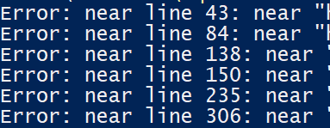

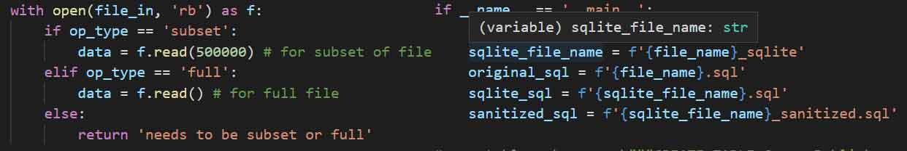

TROUBLES ‘N’ TURMOIL
160GB Database
Memory Error Big Data, Big Problems User Input Shenanigans \\, Big Tables, Slow Queries

Slide 5
EXPLORATION
Regional influences drive video game trends.
Does regional household income influence the way gamers play and choose games?
Are there correlations between what genres players are likely to buy?
What complementary markets can your company pitch your game to, based on genre?
What is the current gamer trend? Are people spending more or less time gaming currently?
Are there more casual gamers now vs more serious long-term players?

Slide 6
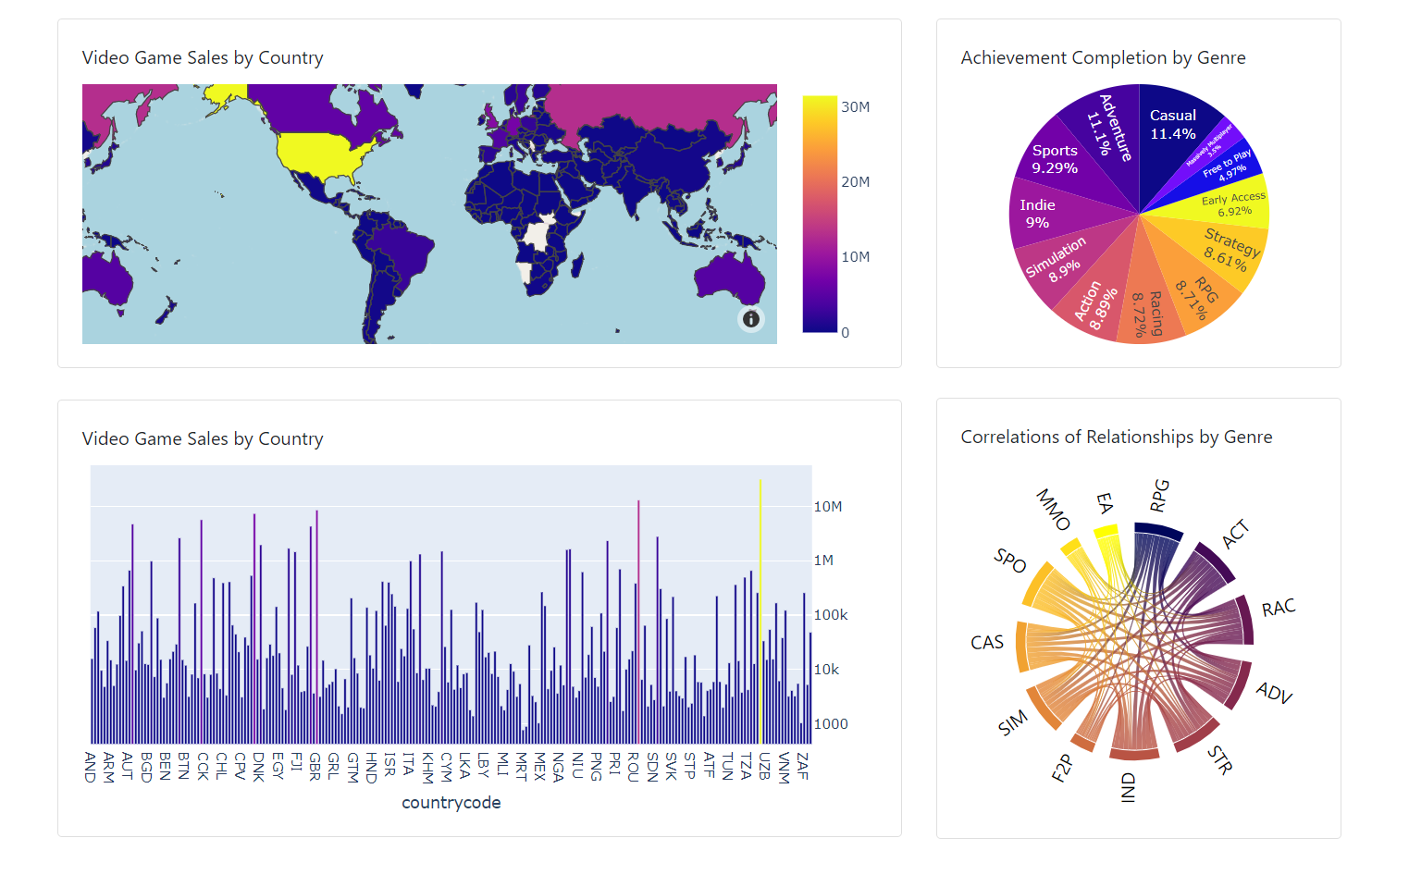
Visualizations and Findings
Analysis Results:
US has a significant higher number of gamers than the rest of the world, distantly followed by Russia/Germany.
More gamers identify as casual gamers than any other type.
Strong correlations exist between genre ownership, while other genres don’t branch out as well.
For a more accurate study, we’d need:
Better collection of data-over-time
Tools that are able to handle significantly larger file sizes

